Slide 1
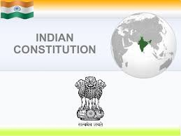

Slide 2
Constitution of India
Meaning of Constitution
Constitutional law
Constitutionalism

Slide 3
Meaning of Constitution

Slide 4
Almost everything we do is governed by some sets of rules
We need laws in society so our society can regulate and work properly
They are designed to protect us and our property and to ensure that everyone in society behaves the way that the community aspects them too

Slide 5
Laws tell us what to expect as a consequence of our actions and to keep the society together.
Without law there will be complete anarchy

Slide 6
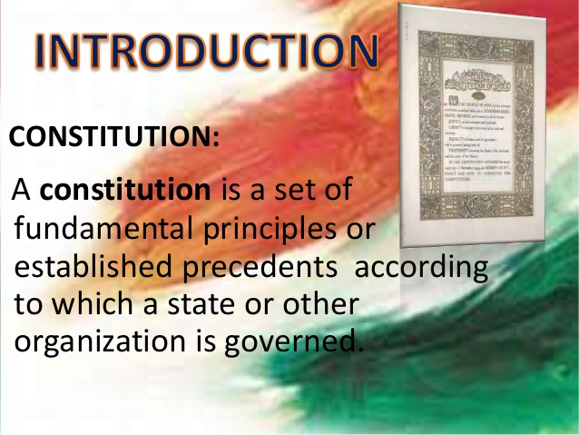

Slide 7
Constitution of a country lays down the basic structure of the political system under which its people are to be governed.
The supreme law of the land
It is the foundation and source of the legal authority underlying the existence of the state
It provides the framework for the organization of the government
It is a basic design, which deals with the structure and powers of the government. It also includes rights and duties of the citizens.

Slide 8
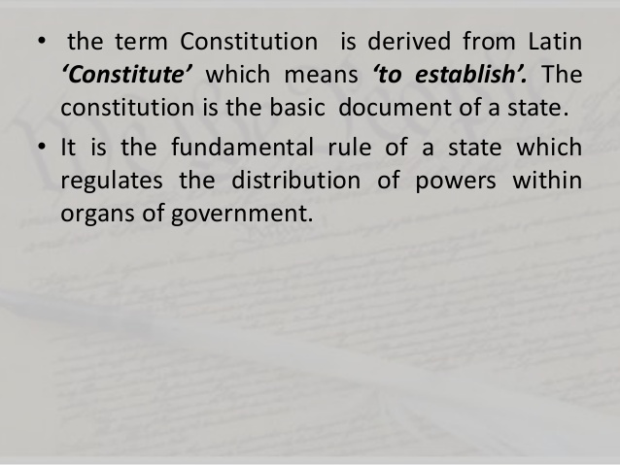

Slide 9
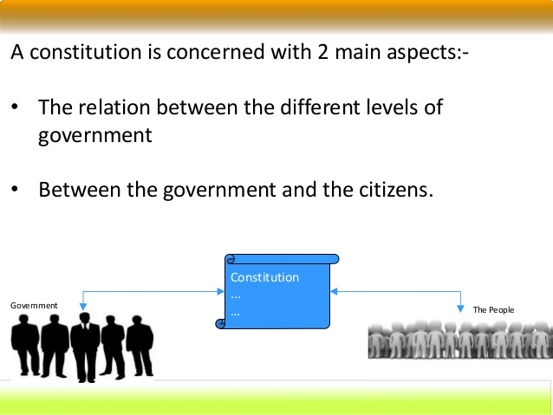

Slide 10
CONSTITUTIONAL LAW
Constitutional law is a body of law which defines the role, powers, and structure of different entities within a state, namely, the executive, the parliament or legislature, and the judiciary; as well as the basic rights of citizens

Slide 11
CONSTITUTIONALISM
Constitutionalism is concerned with both the framework as well as the spirit that breathes within the provisions in that framework
It is comprised of ideas and theories that essentially put limitations on political powers in general, and of the government’s way over citizens

Slide 12
It is a modern concept that desires a political order governed by laws and regulations.
It stands for supremacy of law not for an individuals
It insists limited government
It limits the arbitrary action of government

Slide 13
The principle that insists on organization and working of the state according to the constitution so that no organ and office holder of the state is allowed to use arbitrary power.
It not only provide framework of government but also prescribes powers of government and limits of those powers

Slide 14
System of government in which the governing power is limited by enforceable rules of law and the concentration of power is limited by various checks and balances so that the basic rights of individual and groups are protected

Slide 15
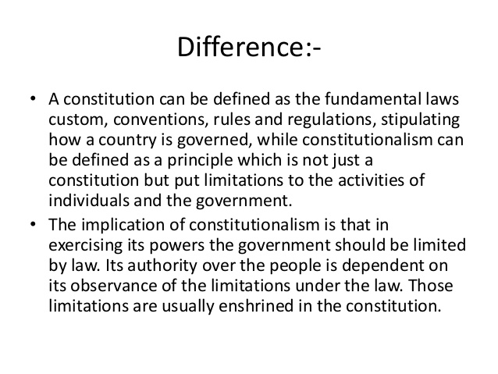

Slide 16
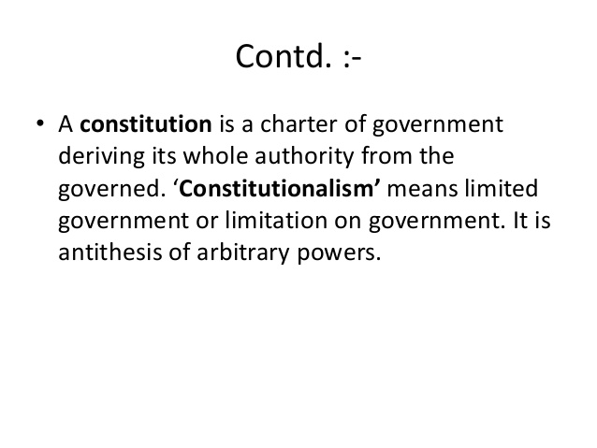

Slide 17
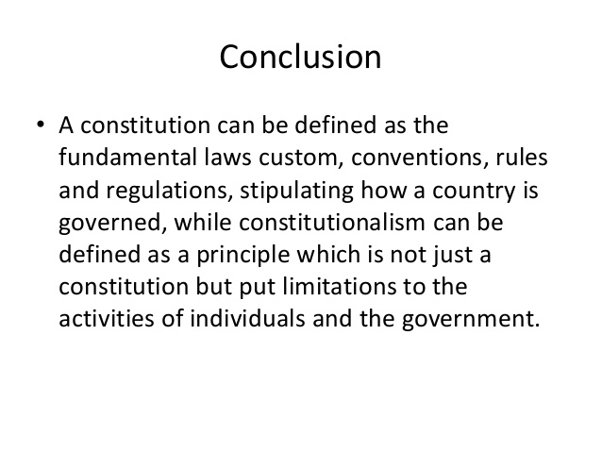

Slide 18
Historical Background of the Constituent Assembly

Slide 19
Constitution of India is the world’s longest written constitution in the world.
Constitution of India contains 448 Articles IN 25 Parts, 12 Schedule and 101 Amendments till date
It was M.N. Roy , who proposed the idea of Independent Constituent Assembly for India in 1934
But it was not accepted by the British Government

Slide 20
After world war 2, most of the Indian leaders resigned from their post to show their dissatisfaction, British brought August offer and Cripp’s Mission in 1940
This time it was rejected by Indians
They demanded to make Constituent Assembly only by the Indians
Finally Cabinet Mission Plan came in 1946

Slide 21
Mission was headed by Staford Cripp, A.V. Alexander and Pethick Lawrence
The total strength of the assembly was389
After partition only 299 were remained
It was partly elected and partly nominated body
In 1948 powers were transferred to Indians
First meeting was held in 9th December,1946
Dr. Sachidanand Sinha was the first temporary president of the Assembly

Slide 22
Second meeting was held on 11th December, Dr. Rajendra Prasad was elected as permanent president of the assembly
Third meeting was held on 13th December, Pt. Nehru brought Objective Resolution
It took 2 years ,11months and 18 days for the final draft
Initially there were total strenght was 389
But after partition 299 remained in India and 90 went to Pakistan( Muslim league)
On 29th August,1947 Drafting committee was constituted

Slide 23
Chairman of the Drafting committee was Dr. B. R. Ambedkar
After 3 drafts finally it was accepted on 26th Nov, 1949
It came into force on 26th Jan,1950

Slide 24
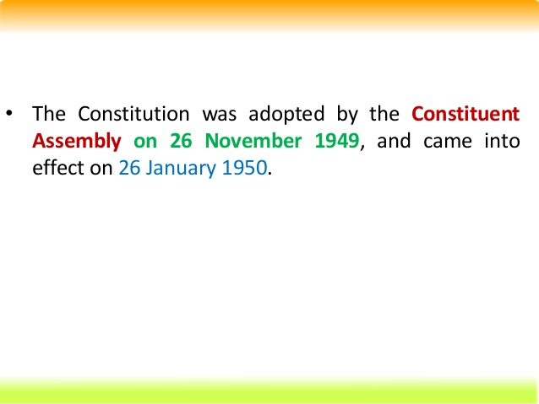

Slide 25
Government of India Act, 1935
This was the longest act so far
It is the main source for the constitution of India
Main sources of this act was Simon Commission and three Round Table Conferences (RTC)

Slide 26
FEATURES OF THE ACT
Formation of All India Federation
Powers will be divided into centre and units
Units will be including Provinces( states) and princely states( ruled by kings)
Princely did not participated
Three list were made and items were divided among them
1. federal list ( for centre with 59 items)
2. provincial ( state with 54 items)
3. concurrent ( for both with 36 items)

Slide 27
Central Government

Slide 28
If the item is not included in any of the list , this will come under Residuary powers.( decided by the Viceroy)
Abolition of provincial dyarchy and introduction of dyarchy in the centre
Dyarchy was introduced at central level
It was divided into two parts

Slide 29
RESERVED
TRANSFERRED
Reserved: administrated by the Viceroy and he can take decisions without advising anyone
Transferred: he has to take advice of others before taking any decisions

Slide 30
Government
1.Central( center)
2. Provincial (state)
Initially dyarchy was in state
Dyarchy ( all subjects will be divided into two)
Reserved ( without consulting)
Transferred (with consultation)

Slide 31
Provincial Autonomy:
Most remarkable feature was provincial autonomy
With the abolition of dyarchy at provivces,the entire provincial administration was instructed to the responsible ministers, who were controlled and removed by the provincial legislatures

Slide 32
Establishment of Federal Court
This act provided the Federal Court to resolve the disputes related to Federal matters( matters between centre and state as well as among states)
The provisions were made for filling the appeal from High Court to Federal Court and from Federal to Privy council( in England)
Today , Federal Court is known as Supreme Court of India

Slide 33
Abolition of Indian Council
Under this act the Indian Council was replaced which was according to 1858 act by the Advisory Council
Secretary of state was provided with a team of Advisors.

Slide 34
Reorganizes the Provinces
Separation of Sind from Bombay
Splitting Bihar and Orissa into separate provinces
Complete separation of Burma from India

Slide 35
Estalishment of RBI
Under this act RBI ( Reserve Bank Of India) was established to control the currency of the country
Other features
Extended franchise
Under this act first time direct elections were done and about 10% of the population got the voting right
This act provided separate electorate for depressed classes e.g. SC , LABOURS ETC

Slide 36
INDIAN INDEPENDENCE ACT, 1947
BACKGROUND
IN 1946,Cabinet Mission came to form constitution of India
On 20th feb, 1947, British Prime Minister Clement Atlee annonuced that They will rule max till 30 June,1948
On 3rd June ,1947, Lord Mountbatten brought Partition plan , which was accepted by both Congress and Muslim League
To implement this plan in action an Act was passed , this is known as Indian Independence Act,1947

Slide 37
Features
The date for transfer of powers was decided on 15th August, 1947
Now India was a Soverign state
Creation of two independent states India and Pakistan was done
Sind decided to join the Pakistan state
Princely states were also free to join any state or remain independent, they choose independent

Slide 38
The authority of British crown over the princely states ( British Paramounty) was removed.
Abolished Viceroy , each state has Governor General post, which is appointed by British crown
British Monarch would no longer use the title “ Emperor of India”
After the states were created, all acts of the British Parliament were removed
Secretary of state( SOS) was abolished

Slide 39
ENFORCEMENT OF THE CONSTITUTION
After three drafts the constitution was adopted on 26th November, 1949
Major part of the constitution was enforced on 26th Jan,1950
Some articles related to elections, citizens, parliament like 5,6,7,8,9,60,364,366,367,380,388,391,392 and 393 were came into force only on 26th Nov, 1949
Total Articles were 395 and 8 Schedules

Slide 40
Salient features of the Constitution
1.Lengthiest and Written Constitution:
Constitution of India is the lengthiest in the world as it has many articles
Originally it had 22 parts, 395 Articles and 8 Schedules. Now it has 25 parts,448 Articles and 12 Schedules
It is a single constitution for both center and state

Slide 41
2. Unique blend of rigidity and flexibility
In terms of flexibility , we can make changes but it needs strong majority in terms of rigidity
3 .Beautiful Patchwork
It has been inspire and derived from various sources. Best features of different constitutions have been incorporated in our constitution . e.g. fundamental rights from US , few words like Republic, Equality, etc from France, Procedures for Amendments from South Africa, Fundamental duties from Russia

Slide 42
4. Parliamentary form of Government
Indian constitution provides parliamentary form of Government .
President is the nominal head of the state.
In actual practice, the Prime Minister and Members of council ministers run the government
5. Fundamental Rights
These are mentioned in Part III ( From A 12 to 35)
Source is USA ,

Slide 43
Initially there were total 7 Fundamental Rights
Now, one is shifted to normal rights so total 6 is remained
Right of equality
Right of Freedom
Right against Exploitation
Right of Freedom of Religion
Right of Culture and education
Right of Constitutional remedies
These are Justiciable

Slide 44
6.Fundamental Duties
These are mentioned in Part IV A
It is derived from Russia
Initially there were 10 fundamental duties and one is added new
Now total 11 fundamental duties in our constitution
These are non Justiciable

Slide 45
7. Directive Principle of State Policy(DPSP)
It is taken from Ireland
It explains the welfare ( social and economic) of the state
Any state and center can make laws on the basis of DPSP
8.Single Citizenship
It provides single citizenship in all states of the country

Slide 46
9. Universal Adult Franchise
Under the constitution each of 18 years or above has right to vote
Initially the age limit was 21 years
10.Integrated and Independent Judiciary
Our judiciary does not work under any group
Integrated means all subordinate court , High Court and Supreme Court are inter connected

Slide 47
11. Emergency Provisions
It was taken from GOI,1935
There are three types of Emergencies
National (A 352)
State(President Rule)(A 356)
Financial(A360)
12.Independent bodies
The constitution provides some independent to perform some specific functions alloted to them

Slide 48
The important bodies are
Election Commission of India (A 324)
CAG( Controller , Auditor General)(A 148)
Union and State Public Service Commissions(UPSC & SPSC) (A315)
13. Federal system but unitary Bias( Quasi federal)
Our constitution is mixture of federal and unitary system
In our nation center is very strong

Slide 49
Some features of unitary system e.g. Single citizenship, appointment of Governors etc
Some federal features in our constitution e.g. written single constitution
14. Three tier Government
In our constitution , initially there were two Governments e.g. Central and State Government
After Amendment, three levels were introduced e.g. Central , State and Local ( Panchayat or Municipality)

Slide 50
PREAMBLE
The term Preamble refers to the Introduction or Preface to the Constitution
It is a kind of Summary or Essence of the constitution
The American constitution was the first to begin the Preamble

Slide 51
The Preamble gives an idea about the following
1. Source of the Constitution
2. Nature of Indian state
3. Objectives of the Constitution
4.Date of Adoption

Slide 52
1. Source of the Constitution
“We the People of India” line is mentioned in our Preamble
It means that People are the main supreme Power ( Source)
Our constitution is by the people and for people

Slide 53
2. Nature of Indian state
Sovereign
Socialist
Secular
Democratic
Republic

Slide 54
Sovereign
India is a sovereign country ( complete independent )
It is free from any other outside power
It has a free Government which is elected by its own people
No outside power can dictate the government
Socialist
It means economic philosophy
In India Mixed Economy is present ( both private and public sector can work together)

Slide 55
Secular
It means all Religions have same status and support from the Government
Democratic
It means supreme power is in the hands of people
A Government is formed by the will of the people
The ruler is elected by the people and are responsible to them

Slide 56
Republic
As opposed to the Monarchy( based on heredity), in India Head of the State is elected member.
In India President Head of the state.
It is not hereditary post, every citizen of India is eligible for the post.

Slide 57
3. Objectives of the Constitution
Justice
Liberty
Equality
Fraternity

Slide 58
Justice
It means fairness in the treatment of people
It may be of three types
SOCIAL
ECONOMIC
POLITICAL
Social : color, caste ,religion ,sex etc
Economic: money ( Rich and Poor)
Political: equal right of voting

Slide 59
Liberty
It means absence of restraint on the activity of individual
It is of five types
Thought
Expression
Belief
Faith
Worship

Slide 60
Equality
It means absence of special privilege
It is of two types
Status
Opportunity

Slide 61
Fraternity
It means feeling of brotherhood
It insures two basic things
Dignity of Individual
Unity and Integrity of the Nation

Slide 62
4. Date of Adoption
Date of adoption of Constitution is 26th November, 1949
But most of the Articles came into force on 26th Jan, 1950
Preamble is adopted on 26th November, 1949

Slide 63
FUNDAMENTAL RIGHTS
These are mentioned in Part III ( A 12 TO A35)
Source is USA ( Bills of Rights)
These are Justiciable
These are provided to secure our Democracy
It is helpful to remove dictatorship
Initially there were total 7 Fundamental Rights
Now , total six fundamental rights are present. Right of Property was removed from the list.

Slide 64
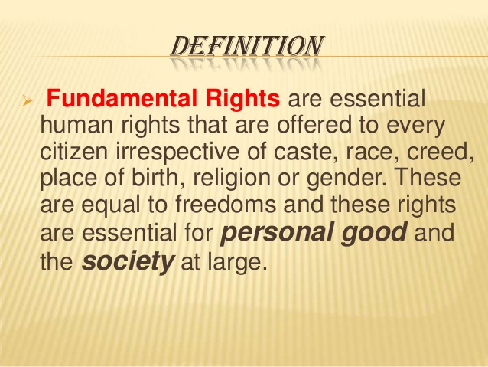

Slide 65
They are not absolute ( have some restrictions)
Governed by Supreme Court
Most of the rights gets suspended during National Emergency

Slide 66
There are total 6 fundamental Rights
Right to Equality( A 14-18)
Right to Freedom ( A 19-22)
Right Against Exploitation ( A 23-24)
Right to freedom of Religion ( A 25-28)
Cultural and Educational Right ( A 29-30)
Right to Constitutional Remedies ( A 32)

Slide 67
1. Right of Equality
It is mentioned from A (14 -18)Some important points mentioned are as follows
1. Equality before law and equal protection of law
It means all citizens are equal, no person is above the law
There will be equal treatment under equal circumstances( Presidents and Governors are excepted)

Slide 68
2.Prohibition of Discrimination
State can not discriminate anyone on the basis of caste, Race, Religion, Gender, place of birth
3. Equality of opportunity in Public employment to all citizens
All citizens are eligible for the public employments. Exceptions ( Backward classes)
4. Abolition of Untouchibility
It prohibits the practice of untouchibility in any form e.g. refusing to enter in any worship area to a person

Slide 69
5. Abolition of Titles:
Prohibits to use any title like Maharaja, Bharat Ratna prefix or suffix

Slide 70
2. RIGHT TO FREEDOM
It is mentioned in the A 19 TO22
It explains the freedom related to the following points
1. freedom of speech and Expression
2. Assemble peacefully without arms
3. To form any Association
4. to move freely throughout the country
5.to settle in any part of the country
6. Practice any profession

Slide 71
Protection in respect of conviction of offence
It tells the protection to the accused person in some circumstances
Protection of life and personal liberty
No person shall be deprived of his life or personal liberty except by the law
Right to education
State shall provide free and compulsory education to all children between age of 6- 14 years

Slide 72
Protection against Arrest and detention
It tells about the conditions to arrest and detention

Slide 73
3. RIGHT AGAINST EXPLOITATION
It is mentioned in A23 and 24
it covers following points
1. Prohibition of Traffic in Human beings & forced labor
If it happens it is punishable
Traffic in human means selling of human beings
2. Prohibition of Employment of children in factories

Slide 74
It explains that children below age of 14 years can cot work in any industry ( mainly Hazardous)
There is also an Act related to it i.e. Child Labour Act,1986)

Slide 75
4. FREEDOM OF RELIGION
According to the constitution all religions are equal before the state. No preference will be given to a particular religion.
Following points are covered
Freedom of conscience & free profession, practice& propagation of religion
Freedom to profess any religion
Freedom to practice any religion
Free to tell others about the religion

Slide 76
Freedom to Manage religion affairs
It explains right to establish& maintain religious and charitable institutes
Right to manage its own affairs in matter of religion( no interference of the state)
Freedom from Taxation for promotion of religion
Freedom to attend religious institutions

Slide 77
5.CULTURAL AND EDUCATIONAL RIGHT
It is under A 29 & 30
Protection of interest of Minorities
Any citizen residing in any part of the country can conserve their language, script and culture
No citizen deny admission in any educational institute , maintained by state government on the basis of religion, caste, race and language

Slide 78
All minorities ( Religious and Linguistic) can setup their own educational institutes to preserve and develop their own culture.

Slide 79
6.Right to Constitutional Remedies
It empowers the citizens to move a court of law in case of any violation of the fundamental right
This can be done by several methods, court can issue various kinds of writs. These are
Habeas Corpus
Mandamus
Prohibition
Certiorari
Quo- Warranto

Slide 80
Fundamental duties

Slide 81
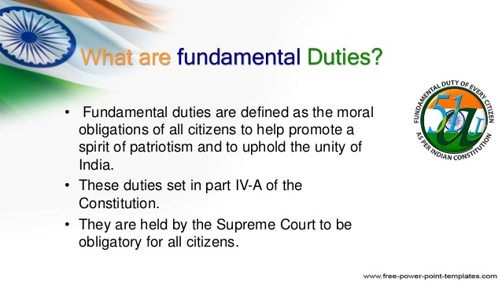

Slide 82
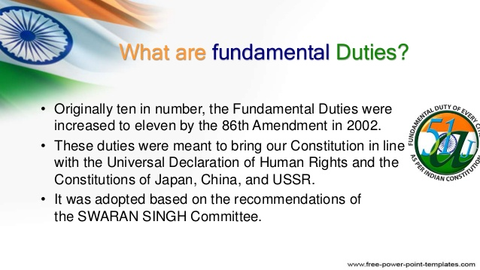

Slide 83
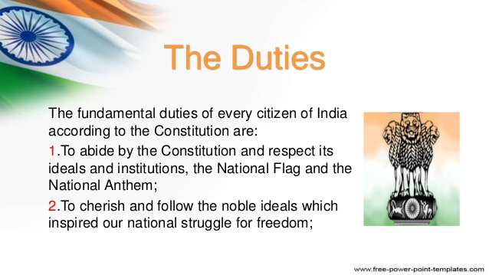

Slide 84
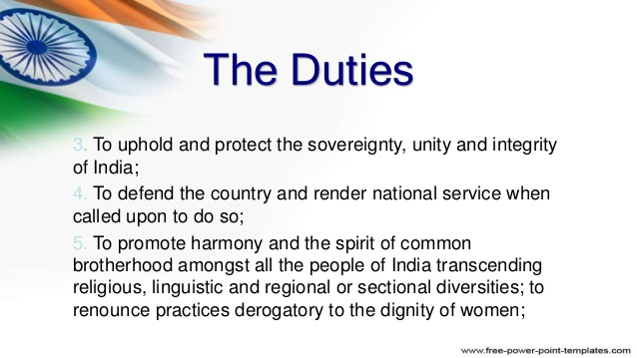

Slide 85


Slide 86
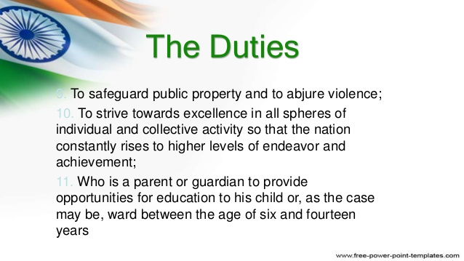

Slide 87


Slide 88
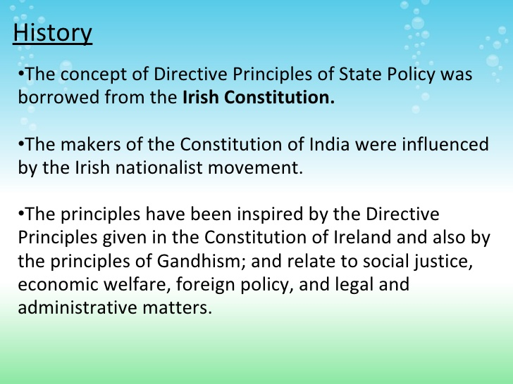

Slide 89
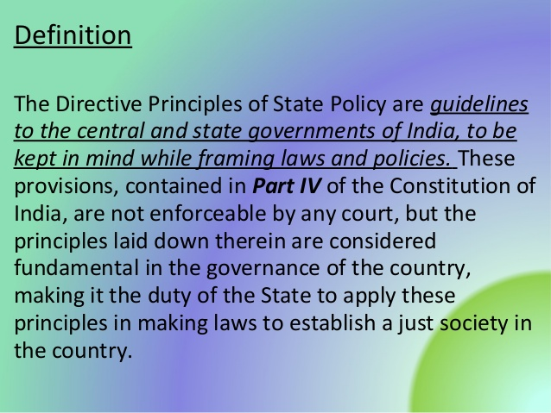

Slide 90
Parts
All principles are divided into three parts
Socialistic Principle
Gandhian Principle
Liberal and intellectual Principles

Slide 91
Socialistic Principles
To promote welfare of people and minimize inequality
Adequate means of livelihood for all citizens
Equal distribution of resources
Prevention of concentration of wealth
Equal pay for equal work for men and women
Prevention of health and strength of the worker and children against abuse

Slide 92
Opportunity for health development of children
To promote equal Justice and provide free legal Aid to the poor
To secure right to work, to educate , public assistance in case of old age and sickness
To make provisions for better working conditions and Maternity Relief
To secure living wages, decent standard of life equal opportunity for workers
To secure participation of workers in Management of industries

Slide 93
To raise the level of Nutrition and standard of living for better public health
Gandhian policies:
To organize village Panchayat and give necessary powers
To promote Cottage industry in Rural areas
To promote Cooperative Societies
To promote education and economic interest of Sc/ST/ weak sections
Prohibition of intoxicating drinks and drugs
To prohibit slaughtering of cows and calves

Slide 94
Liberal and Intellectual Principles
Uniform civil court through out the country
Provide childhood education till the age of 6 years
Organize agriculture into Modern and scientific line
To protect and improve wildlife and forest
To protect Monuments and places of National importance
To promote International Peace

Slide 95
PARLIAMENTARY SYSTEM
It is also known as Cabinet Government
It is in which Executive is responsible to the Legislature
It was originated in Britain

Slide 96
Features
1. Dual Executive
There are two Executives
Real
Nominal
The President is the Nominal Executive and PM is the Real Executive
The President is the Head of the State and PM is the Head of the Government

Slide 97
2. Majority Party Rule
The party or a group of parties secure a majority in the Lok Sabha form the Government
The leader of the party is appointed as PM by the President
Other Ministers are appointed by the President on the advice of PM

Slide 98
3. Collective Responsibility
It is a very important principle
It is a BEDROCK principle of the parliamentary system
The Ministers are collectively responsible to the Parliament

Slide 99
4. Political Homogeneity
Usually the members of council of ministers belong to the same party, hence share the same political ideology
If coalition , members are bound to the consensus.
5. Double Membership
Ministers are the member of both the Legislature and executive

Slide 100
6. Dissolution of the lower House
Lower house (Lok Sabha) can be dissolved by the President on the recommendation of PM
7. Secrecy
Ministers work on the principle of secrecy, cannot divulge the information about the policies and decisions

Slide 101
FEDERAL SYSTEM
It is a system in which powers are divided and shared by central and state Government
Features
Dual Polity: powers are divided into central and state level
Division of Powers: Matters related to Defence, Currency and foreign are controlled by the central Government

Slide 102
Matters related to Agriculture, Health and public orders are controlled by State only
Supremacy of Constitution
Constitution is at the top. Both governments will follow the laws mentioned in the constitution
Written Constitution: as in federal system, there are two governments.
Both governments have the same rules and regulations as mentioned in the constitution.

Slide 103
Rigid Constitution
The process for amendment in the constitution is very complicated
No government can bring any changes easily
Different kinds of majority is required for passing the Bill
Independent Judiciary
There is a free Judiciary , which will give decisions independently.
There should not be any favour due to any pressure

Slide 104
CENTRE – STATE RELATIONS
Our constitution is federal in nature
All powers are divided into centre and state
Only judicial powers are not divided
All powers can be divided in to three
1. Legislative Powers
2. Administrative Powers
3. Financial Powers

Slide 105
Legislative Powers
It can be explained in four points
1. Territorial Extent
2. Distribution of legislative subjects
3. Parliamentary legislation in state field
4. Centre control over state legislation

Slide 106
1. Territorial Extent
Parliament can make law for whole or any part of India
Law made by state are not applicable outside state
Law made by parliament are also applicable to Indian citizens outside India

Slide 107
2. Distribution of Legislative subjects
All subject matters were divided into 3 list
1. Union list
2. State list
3. Concurrent list
1. Union list : it is controlled by central government
E.g. Banking, Currency, Defense, foreign Affairs

Slide 108
2. State list : it is control by state government
E.g. Agriculture, sanitation, Health ,Public orders
3. Concurrent : Coalition control
E.g. Divorce, Marriage, education

Slide 109
3. Parliamentary legislation in the state field
During normal time distribution of legislation is to be maintained . But during abnormal conditions like National Emergency, request made by state, to implement international Agreement , during Presidential rule , distribution is either suspended or modified.

Slide 110
4. Central control over state legislation
Governor can reserve certain bills passed by the state for consideration of President
Bills on certain matters listed in the state list can be introduced only with the prior permission of the President
The President can direct the state to reserve money bills and financial bills during the financial Emergency.

Slide 111
Administrative Powers
From (A 256 to 263)
It covers following points
1. Distribution of powers
Centre will execute union list and state will execute state list
Concurrent matters will be done by both

Slide 112
2. Obligation of the states and centre
State have to follow the laws made by the parliament
If not, there will be Presidential rule in the state
3. Centre direction to the state
Centre can give the directions to the state on the following points
A. construction and maintenance of mode of communication
B. Measures to be taken for protection of Railways
C.Provide facility to promote mother tounge

Slide 113
4. Cooperation between centre and state
Parliament can provide adjudication on any interstate dispute on river water
President can make any inter state council
5. All India Services
IAS,IPS,IFS are controlled by the centre only

Slide 114
3. Financial Powers
It deals with A 268 -293
It explains the financial relations between centre and state
1. Allocation of Taxing Powers
Parliament has power to put taxes on union list
State has power to put taxes on state list
Both have power for concurrent list

Slide 115
2. Distribution of taxes revenue
There are several conditions
A. taxes levied by centre but collected by state. e.g. stam duties, cheques,excise duties on medicinal products etc
B. service tax levied by the centre but collected by both centre and state
C. taxes levied and collected by the centre but assigned to the state e.g. On sale and purchase of interstate goods (except Newspaper)

Slide 116
D. taxes levied and collected by the centre but distributed between centre and state e.g all taxes and duties in the union list
E. taxes levied & collected and retained by the state e.g. land revenues, agricultre

Slide 117
6. Borrowing by the centre and state
Centre can borrow within India as well as outside
State can borrow with in India only
Centre can give loan to the state
State can not raise any loan without consent of the centre

Slide 118
Amendments of Constitutional Powers and Procedures
Parliament can bring any changes
It is without changing the basic structure
Procedure
1. introduction of the Bill in any of the house
It can be introduced by any parliament member or private member
2. it should be passed by both the houses by special majority

Slide 119
4. Each house will pass the bill, separately
5. If it is related to the state , state rectification will be followed
6.Now, bill will be presented to the President
7.President has to give his assent to the bill, it is now known as ACT
Amendments can be done by three ways
1. By simple majority of the parliament
2. By special majority of the parliament
3.by special majority of the parliament and ratification of half of the population

Slide 120
1.By Simple Majority
It means (50% +1) members present and voting
It is also known as working Majority
It is used in the following areas
a. establishment of new state
B. to pass money bill, financial bill, etc

Slide 121
2. Special Majority:
It requires 2/3 of members present and voting and more than 50% of the total members of each house
It is used in fundamental rights , DPSP etc
3. special Majority with state Rectification
It requires (50%+1) , 2/3 of present and voting and half of the state legislature
It is used for selection of President , supreme court and high court etc

Slide 122
Emergency Provisions
It is defined as a situation which is not normal, which calls for immediate remedial action
Source is GOI , 1935

Slide 123
Types
1. NATIONAL EMERGENCY (A 352)
2 STATE EMERGENCY ( Presidential Rule) (A 356)
3. FINANCIAL EMERGENCY( A 360)

Slide 124
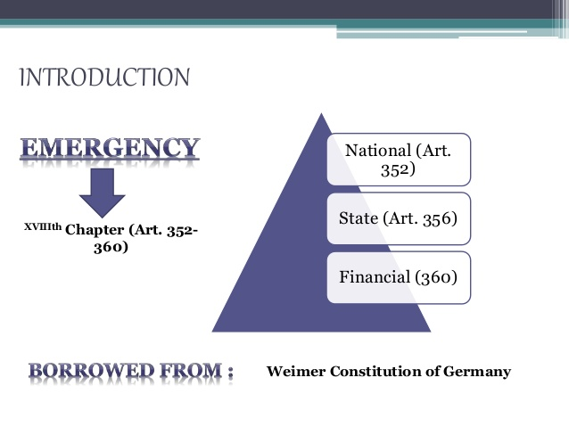

Slide 125
NATIONAL EMERGENCY
An Emergency due to war, External Aggression and Armed Rebellion (Internal Disturbance)
President can impose on the basis of written advice of cabinet
It may be imposed in the whole country or in some part
During war and external aggression it is known as External emergency
During Armed Rebellion it is known as Internal

Slide 126
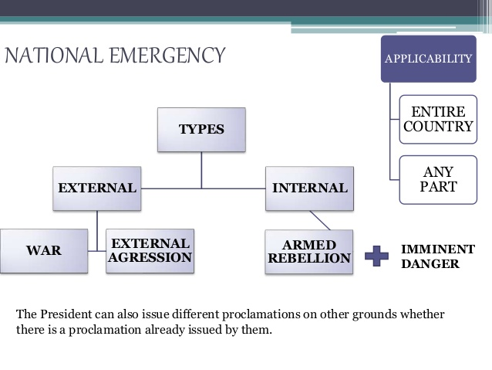

Slide 127
Revocation
It can be revoked by the President without any approval of the parliament
If the Lok Sabha passes a resolution to revoke it

Slide 128
EFFECTS
It consequences can be done in three categories
1. effects on centre –state relations
2. effects on life of loksabha
3. effects on fundamental Rights

Slide 129
1.Effects on Centre –State Relations
Centre can give direction to state on any matter
State governments are brought under the complete control of the centre, but not suspended
Parliament empowered to make any law on the any subject mentioned state list
President can modify distribution of revenues between centre and state

Slide 130
Effects on Life of the Loksabha
The life of loksabha can be extended beyound its normal time
effects on fundamental Rights
Fundamental rights automatically suspended

Slide 131
Presidential Rule
It is also known as State or Constitutional emergency
It is also imposed by the President
Ground
1.If the state government is not working according to the provisions of the constitution
2. When state fails to follow any directions given by the centre

Slide 132
It can be revoked by the President any time
Effects
1.president dismisses the council of ministers headed by the chief minister
2.president take all functions and powers of state authority
3. state legislature remains suspended or dissolved

Slide 133
Financial emergency
President can impose this if there is financial stability threat in any part of the country
The financial emergency continues indefinitely till it is revoked

Slide 134
Effects
1. All state finance related matters will be restricted and given to the centre
2. reduction an salary and allowances for all in the Union and state
3. President can reserve any money bill and financial bills
4. reduction in salaries and allowances of Judges of Supreme Court and High Court

Slide 135
Local Self Government
As India is a Federal system . Powers are divided in to Centre and State level.
Initially there was no power to the local level, so local issues were not reaching to the government
To remove the decentralization , and to promote direct democracy local self government came in the system
Local people governs themselves

Slide 136
“Local self-government is an institution comprising of locally elected representatives managing the affairs of the locality and providing them with basic amenities”.
Local government is divided into two parts
1. Panchayati Raj : In Rural area such an institution is called as Panchayati Raj
2. Municipal Corporation or Municipality: In Urban areas it is known as Municipal Corporation or Municipality.

Slide 137
Importance of Local Self Government
It provides the foundation for the Democratic structure
Local people know their problems well and can suggest better solutions
Encourage self-help & voluntary service & saves expenses
Government can reach Ordinary people Lessens burden of State & Central Government

Slide 138
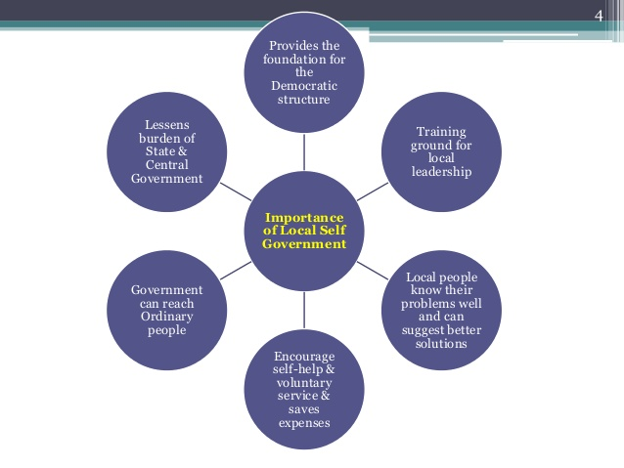

Slide 139
Panchayati Raj (Rural )
Three Tier System of Panchayati Raj in Rural Areas
Gram Panchayat ( at Village level)
Panchayat Samiti ( at Block level)
Zila Parishad ( at District level)

Slide 140
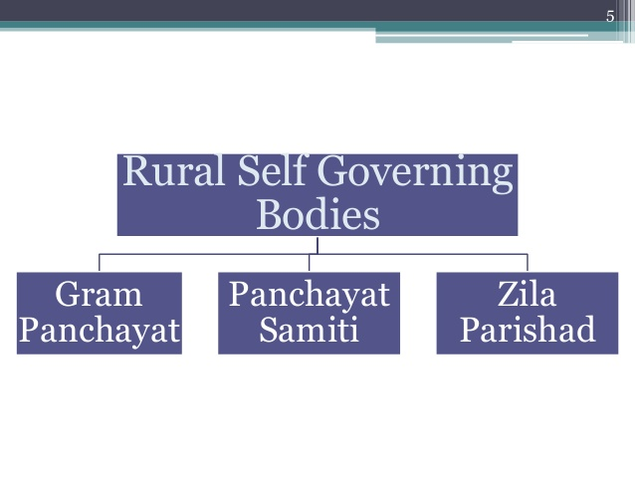

Slide 141
Gram Panchayat
The ‘Gram Sabha’ is the centre of self- governance at the village-level.
‘Gram Panchayat’ is the ‘Executive body’ of the Gram Sabha.
The members of Gram Panchayat are elected by the Gram Sabha

Slide 142
Composition
1. Sarpanch/Pradhan (President) &
2. Vice-President of the Gram Sabha
Only those person can become members of Gram Panchayat who is:
21+ years of age
Registered voter of the constituency
Mentally sound
He should not be a convict/criminal

Slide 143
He should not be disqualified under any law made by State or Union Legislature.
He should not hold any office of Profit under Government of India.
Reservation: Seats will be reserved for SC/ST and Women.

Slide 144
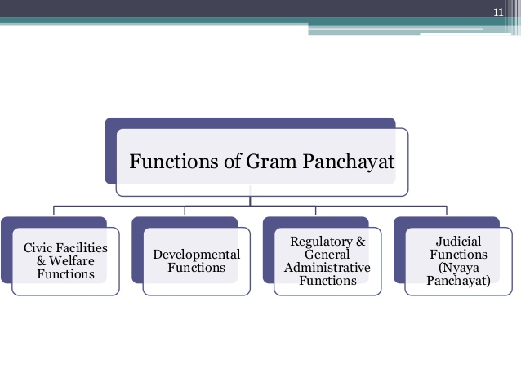

Slide 145
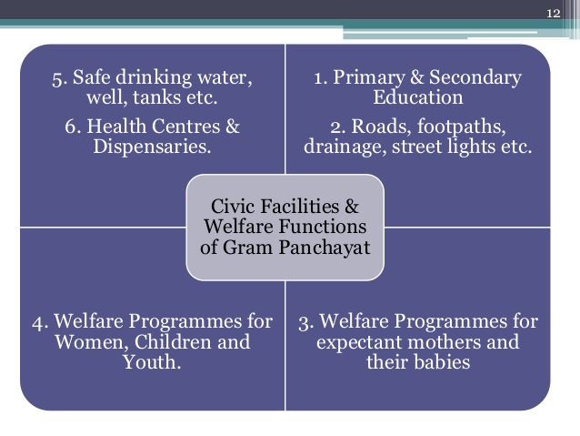

Slide 146
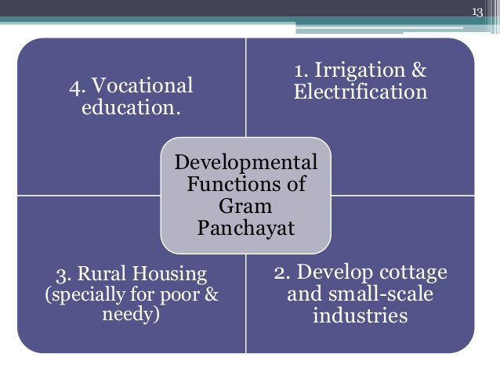

Slide 147
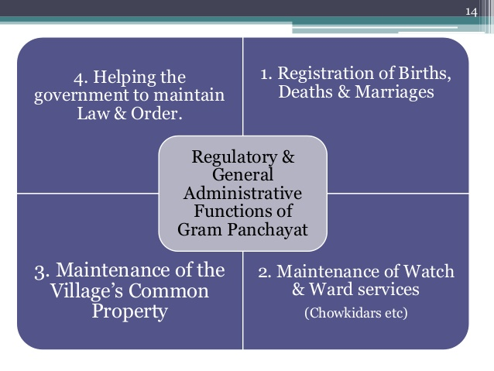

Slide 148
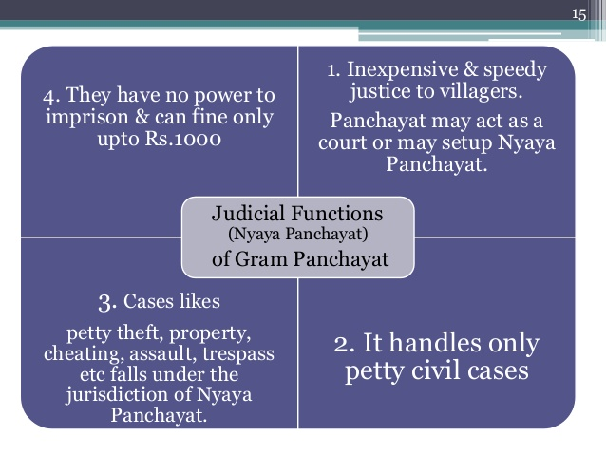

Slide 149
Panchayat Samiti
At the Block Level
The ‘Panchayat Samiti’ is an intermediate body which coordinates the activities of all Village Panchayats in each Block.
It has different names in different states. E.g. Kshetra Samiti , Janpada Panchayat, Taluka Panchayat , Panchayat Samiti
The Chief Administrative Officer of Panchayat Samiti is known as Block Development Officer (BDO).

Slide 150
Chairperson of the samiti is Block Pramukh , elected by its own memebers
Members are Sarpanchs (Presidents) of the Panchayats within the Block, 2. BDO, MPs, MLAs, & MLCs of that area.

Slide 151
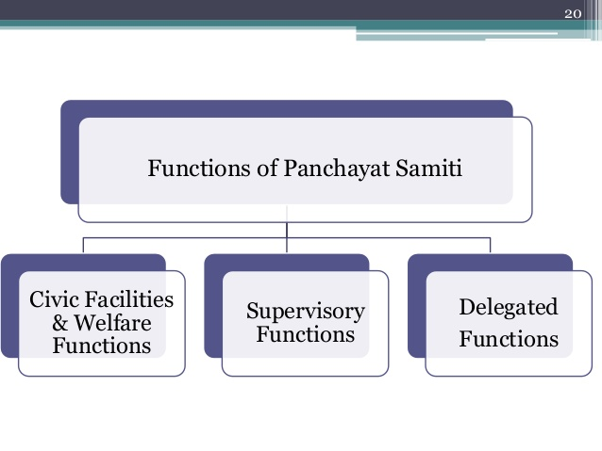

Slide 152
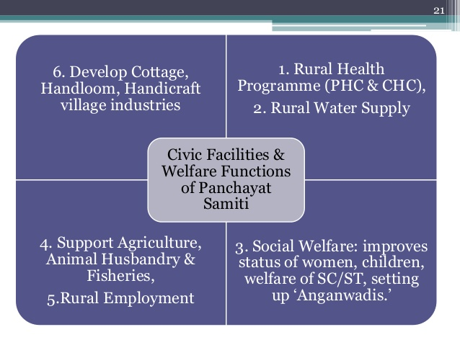

Slide 153
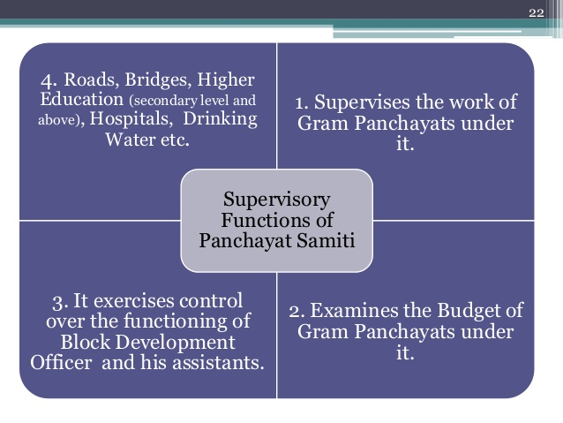

Slide 154
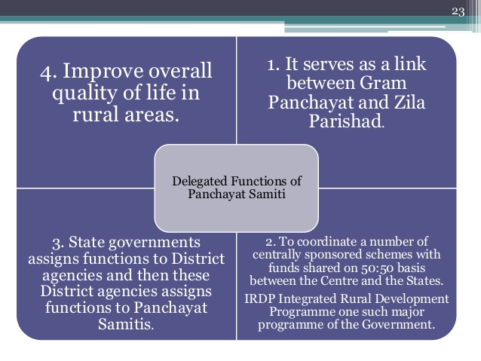

Slide 155
Zila Parishad (At the District Level)
The ‘Zila Parishad’ is an apex (highest) body under Panchyati Raj.
It coordinates various activities of the various Panchayat Samitis.
BDOs, MPs, MLAs of that district , Block Pramukh are members
Head is CEO (Non elected person e.g. IAS officer)

Slide 156
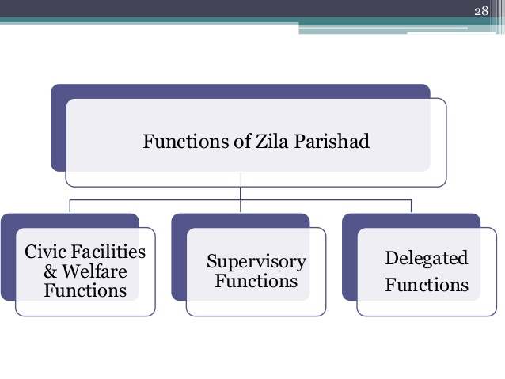

Slide 157
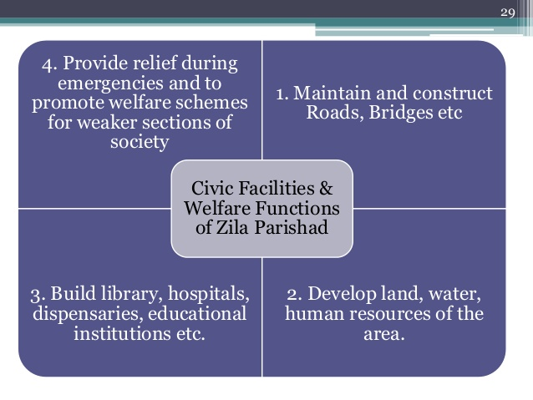

Slide 158
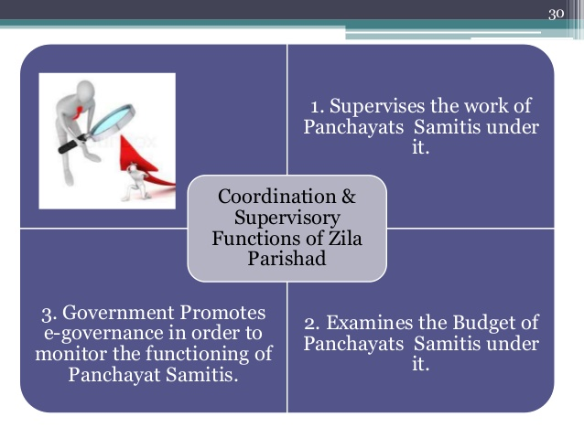

Slide 159
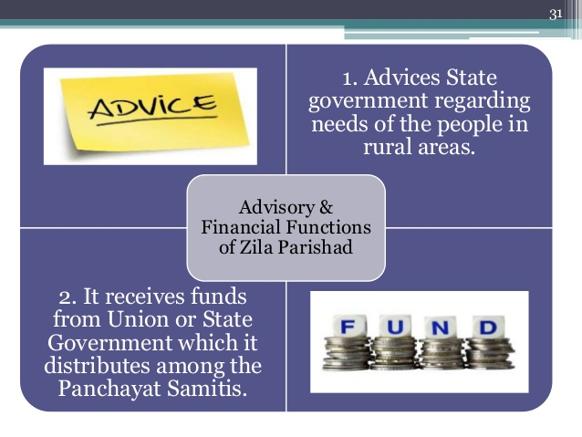

Slide 160
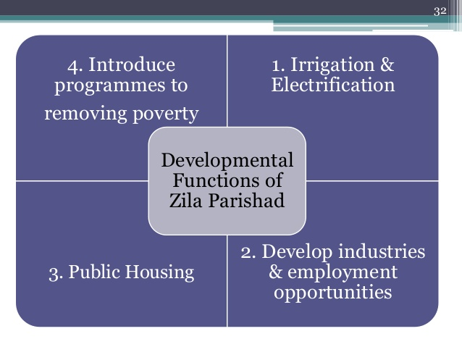

Slide 161
Urban Local Government
It is associated with urban areas
It is divided into three areas
1. Nagar Panchayat
2. Municipal Council
3. Municipal Corporation

Slide 162
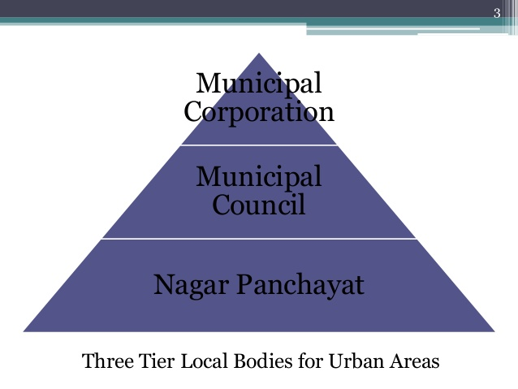

Slide 163
1. Nagar Panchayat:
It is also known as Nagar Parishad .
It is for transition cities
2. Municipal Council (Nagar Palika)
It works for small cities , population over 80,000
Members are councilors
3. Municipal Corporation
It is for big cities
It is also known as Nagar Nigam
Head is known as Mayor

Slide 164
It is in the cities more than 10 lakhs population

Slide 165
Functions
1. health and sanitation
2. electricity
3. water supply
4.education etc

Slide 166
UNIT 2

Slide 167
POWERS OF THE PARLIAMENT
It has multi functions
All powers and functions can be classified in to following categories
1. Legislative
2. Executives
3. financial
4. Constituent
5. Judicial
6. others

Slide 168
Functions of Rajya Sabha
It is also known as permanent house or council of state
It gives representation to the States of the Indian.
The Rajya Sabha can have a maximum strength of 250 members
The members of the Rajya Sabha are elected indirectly by the people.

Slide 169
Functions
1. Legislative Powers: In law-making the Rajya Sabha enjoys equal powers with the Lok Sabha.
An ordinary bill can be introduced in the Rajya Sabha and it cannot become a law unless passed by it.
In case of a deadlock between the two Houses of Parliament over an ordinary bill and if it remains unresolved for six months

Slide 170
the President can convene a joint sitting of the two Houses for resolving the deadlock
2. Financial Powers:
In the financial sphere, the Rajya Sabha is a weak House.
A money bill cannot be introduced in the Rajya Sabha.
It can be initiated only in the Lok Sabha.
A money bill passed by the Lok Sabha comes before the Rajya Sabha for its consideration.

Slide 171
If the Rajya Sabha proposes some amendments and the bill is returned to the Lok Sabha, it depends upon the Lok Sabha to accept or reject the proposed amendments.
3. Executive Powers:
Rajya Sabha cannot remove the Ministry
Rajya Sabha can exercise some control over the ministers by criticising their policies, by asking questions and supplementary questions,

Slide 172
4. Constituent Powers
Rajya Sabha and Lok Sabha can together amend the constitution by passing an amendment bill with 2/3 majority in each House.
5. Electoral Powers:
The Rajya Sabha has some electoral powers also.
The elected members of the Rajya Sabha along with the elected members of the Lok Sabha together elect the President of India.

Slide 173
The members of the Rajya Sabha Lok Sabha together elect the Vice- President of India.
Members of the Rajya Sabha also elect a Deputy Chairman from amongst themselves.
6. Judicial Powers:
(a) The Rajya Sabha acting along with the Lok Sabha can impeach the President on charges of violation of the Constitution.

Slide 174
(b) The Rajya Sabha can also pass a special address for causing the removal of a judge of the Supreme Court or of any High Court.
(c) The charges against the Vice-President can be leveled only in the Rajya Sabha.
(d) The Rajya Sabha can pass a resolution for the removal of some high officers like the Attorney General of India, Comptroller and Auditor General and Chief Election Commissioner.

Slide 175
Two Special Powers of Rajya Sabha.
The Rajya Sabha enjoys two exclusive powers:
(i) The Power to declare a subject of State List as a subject of National Importance:
(ii) Power in respect of Creation or Abolition of an All India Service:

Slide 176
(i) The Power to declare a subject of State List as a subject of National Importance:
The Rajya Sabha can pass a resolution by 2/3rd majority of its members for declaring a State List subject as a subject of national importance. Such a resolution empowers the Union Parliament to legislate on such a state subject for a period of one year. Such resolutions can be repeatedly passed by the Rajya Sabha.

Slide 177
ii) Power in respect of Creation or Abolition of an All India Service:
The Rajya Sabha has the power to create one or more new All India Services. It can do so by passing a resolution supported by 2/3rd majority on the plea of national interest. In a similar way, the Rajya Sabha can disband an existing All India Service.

Slide 178
Functions of Lok Sabha
The House of the People is popularly known as the Lok Sabha.
It is the lower and powerful house of the Union Parliament.
It represents the people of India. It is directly elected by all the people.
It is fully democratic, representative and national House.

Slide 179
The present membership of the Lok Sabha is 545
The normal term of the Lok Sabha is five years.

Slide 180
Functions
1. Legislative Powers:
An ordinary bill can become law only after it has been passed by both the Houses of Parliament.
It can be introduced either in the Lok Sabha or the Rajya Sabha.
almost 90% of the bills are actually introduced in the Lok Sabha.

Slide 181
2. Executive Powers:
The leader of the majority in the Lok Sabha becomes the Prime Minister.
Most of the ministers are from the Lok Sabha.
The Lok Sabha can remove the ministry from office by passing a vote of no- confidence against it.
Thus, the life and death of the Ministry depends upon the Lok Sabha.
The Lok Sabha maintains a continuous control over the Council of Ministers.

Slide 182
3. Financial Powers:
The Lok Sabha has vast financial powers.
A money bill can be introduced only in the Lok Sabha.
After having been passed by it, the money bill goes to the Rajya Sabha. Such a bill can be delayed by the Rajya Sabha for a maximum period of 14 days.

Slide 183
If the Rajya Sabha fails to pass a money bill and 14 days elapse from the date of the submission of the bill
Then the money bill is deemed to have been passed by both the houses of Parliament.
It is sent to the President for his signature.
Lok Sabha has the final control over the finances of state.
No tax can be levied or collected or changed or abolished without the approval of the Lok Sabha.

Slide 184
4. Judicial Powers:
The impeachment proceedings can be taken up against the President either in the Lok Sabha or the Rajya Sabha.
The President can be removed from office only when an impeachment resolution is adopted by each of the two Houses with a 2/3 majority of its members.

Slide 185
The Lok Sabha also investigates the charges prepared by the Rajya Sabha against the Vice-President of India.
The Lok Sabha and the Rajya Sabha can together pass a resolution for the removal of any judge of the Supreme Court or of a State High Court.
Lok Sabha can also take action against any member or any citizen who is held to be guilty of committing contempt of the House.

Slide 186
5. Electoral Functions:
The Lok Sabha also performs some electoral functions.
The elected members of the Lok Sabha take part in the election of the President.
Members of the Lok Sabha and the Rajya Sabha together elect the Vice-President of India.
The members of the Lok Sabha also elect a Speaker and a Deputy Speaker from amongst themselves.

Slide 187
Powers and functions of the President
1. Executive Powers:
The entire administration of Government of India is conducted in the name of the President of India.
He has the right to seek information.
He is vested with the powers of appointment and removal.

Slide 188
He appoints the Prime Minister and on his advice the other ministers.
He appoints the Judges of the Supreme Court and the High Courts, the Governors of the states, the Attorney General, the Comptroller and Auditor General, the Chairman and members of the Public Service Commission, the members of Election, Finance, and the Official Languages Commissions.
The administration of Union Territories is directly under his control.

Slide 189
He is empowered to appoint a Commission to investigate into conditions of backward classes.
He is vested with the authority to remove his Ministers, the Governors, the Attorney General, Judges and Chief Justice of Supreme and High Courts, Chairman and members of Union Public Service Commission and that of the State Public Service Commissions
The President has the power of directing, controlling and coordinating the State Government from time to time.
He can establish an Inter-State Council

Slide 190
2.Legislative Powers
(i) To Summon the Parliament and Dissolve the Lower House:
He has the power to summon and provogue the Parliament and dissolve the Lok Sabha.
He can convene a joint session of both the Houses.
.

Slide 191
(ii) To Address Either House of Parliament:
address is delivered on the opening day of the session of Parliament and also at the first session each year.

Slide 192
To Accord Assent on the Bills:
Every bill passed by both Houses of Parliament, is to be presented to the President for his assent.
His recommendation essential on certain state Bills.
His sanction over certain state Bills before introduction within the House.

Slide 193
No bill for the formation of new State and the alteration of areas, boundaries, or names of the existing State can be introduced in either House of Parliament except on the recommendation of the President.
Nominates twelve members of Rajya Sabha and two anglo Indians.
He promulgates ordinances when parliament is not in session.
The president appoints the offices of the Speaker and the Deputy Speaker of the Lok Sabha , if it is vacant

Slide 194
3. Financial Powers
No money Bills can be introduced in the Parliament except on the President’s recommendation.
The Contingency Fund of India is at his disposal.
He can establish Finance Commission

Slide 195
4. Judicial Powers
As regards his judicial powers, the President can grant pardons, reprieves, respites or remissions of punishments.
He can suspend, remit or commute the sentence of any person convicted of any offence

Slide 196
5. Military Power
The President is the supreme commander of the defense forces of the country
He can declare national emergency
Appoints chiefs of Army, Navy and Air force

Slide 197
6.Diplomatic Powers
As the Head of the State, the President sends and receives ambassadors and other diplomatic representatives.
All treaties and international agreements are negotiated and concluded in the name of the President

Slide 198
COMPARISON OF POWERS
Manner of election
US president is more or less directly elected whereas the Indian president is indirectly elected. The advantage of the directly elected head of the government is the stability of the government.

Slide 199
Head of the State
The US President is both the Head of the State and Head of the Government, whereas the Indian president is only the head of the State. President of the US is the real executive. Term of office
American President holds the office for 4 years and he can seek re-election only once, while the Indian president holds the office for 5 years and is eligible for re-election any number of times.

Slide 200
Responsibility to Legislature
The US president is not part of any legislature and is not responsible to the legislatures. In India, the Parliament includes the President and the two houses- Lok Sabha and Rajya Sabha.

Slide 201
Removal process
In India either house can initiate impeachment proceedings against the president and with the concurrence of the other house can impeach the President. In US the power to impeach solely lies with the Senate (upper house).

Slide 202
Veto power
Indian President has comparatively lesser veto power than the President of US.
Dissolving the legislature
The Indian President can dissolve the Parliament while the US President does not have such powers.

Slide 203
Powers and functions of Prime Minister
The office of the Prime Minister is the most powerful office in India.
He is the Head of the Government of India.
1. Formation of the Council of Ministers:
The task of formation of the ministry begins with the appointment of the Prime Minister by the President.
After the appointment of Prime Minister, the President appoints all other ministers on the advice of the Prime Minister.

Slide 204
2. Allocation of Portfolios:
It is an undisputed privilege of the Prime Minister to allocate portfolios to his ministers.
Which particular department is to be given to which minister is determined by him.

Slide 205
3. Change of Portfolios:
The Prime Minister has the power to change the departments (portfolios) of the ministers at any time.
4. Chairman of the Cabinet:
The Prime Minister is the leader of the Cabinet.
He decides the agenda of its meetings. In fact all matters in the Cabinet are decided with the approval and consent of the Prime Minister.

Slide 206
6. Chief Link between the President and the Cabinet:
The Prime Minister is the main channel of communication between the President and the Cabinet. He communicates to the President all decisions of the Cabinet, and puts before the Cabinet the views of the President.

Slide 207
7. Chief Coordinator:
It is his responsibility to co-ordinate the activities of all the departments and to secure co-operation amongst all government departments. He resolves all differences, among the ministers.

Slide 208
8. Leader of the Parliament:
As the leader of the majority in the Lok Sabha, the Prime Minister is also the leader of the Parliament.
The summoning and the proroguing of Parliament is in fact decided by him and the President only acts upon his advice.

Slide 209
9. Power to get the Parliament Dissolved:
The Prime Minister has the power to advise the President in favour of a dissolution of the Lok Sabha
10. Director of Foreign Affairs:
As the powerful and real head of the government, the Prime Minister always plays a key role in determining Indian foreign policy and relations with other countries.

Slide 210
11. Role as the Leader of the Nation
Besides being the leader of his party and the Lok Sabha, Prime Minister is also the leader of the nation.

Slide 211
Independence of Judiciary in India
It means “The decisions of the judiciary should not be influenced by either the Executive or the Legislature—it means freedom from both, fear and favour of the other two organs.”
The Constitution of India envisages an independent Supreme Court.
.

Slide 212
This is the institution which will preserve those fundamental rights and secure to every citizen, the rights that have been given to him under the Constitution.
It is essential for maintaining purity of justice in the social system

Slide 213
Methods to Secure Independence of Judiciary
(a) High Qualifications:
Politics in the appointment of judges has been avoided by prescribing high minimum qualifications for such assignments in the Constitution itself.
b) Handsome Remuneration Subject to Vote of Legislature:
every judge is paid a high salary to maintain his status and dignity.

Slide 214
(c) Security of Tenure:
The Judges of the Supreme Court enjoy security of tenure. They are not removable from office except by an order of the President and that also only on the ground of proved misbehavior or incapacity, supported by a resolution adopted by a majority of total membership of each House and also by a majority of not less than 2/3 of the members of that House present and voting.

Slide 215
(d) Lengthy Tenure:
Although the Constitution does not provide for life tenure, the existing provision of 65 years
Moreover, a retired judge according to Article 128, may be reappointed a judge by the Chief Justice of India, with the consent of the President.

Slide 216
e)Powers to Make Rules to Regulate their Procedure
The Supreme Court is equipped with full powers to make rules for regulating its practice and procedure and to take effective steps for the enforcement of its orders.
f) Control over Establishment:
The Court is fully authorized to have its own establishment and have complete control over it.

Slide 217
all appointments of officers and servants of the Supreme Court are made by the Chief Justice and the judges of the Supreme Court whom he may direct for the purpose. Their conditions of service also are determined by the Supreme Court.
g)Denial of Political Office before or after Retirement
The judges should not be allowed to hold political office after retirement

Slide 218
h) Immunities:
The actions and decisions of the judges in their official capacity are immune from criticism.

Slide 219
SUPREME COURT
The Supreme Court is the highest court of law.
Originally there was a provision in the Constitution that there will be Chief Justice and seven other judges.
At present total strength is 31

Slide 220
Appointment of Judges
To eliminate politics in the appointment of judges, high minimum qualifications have been prescribed.
(a) a citizen of India and
(b) either a distinguished jurist; or has been a High Court Judge for at least 5 years or has been an Advocate of a high Court (or two or more such Courts in succession) for at least 10 years

Slide 221
Appointment of Judges
The President is the appointing authority in the case of judges of the Supreme Court.
While making appointment of the Chief Justice of India, he may consult such of the judges of the Supreme Court and of the High Court’s as he might consider necessary.
While making appointment of other judges of the Supreme Court, the Chief Justice shall always be consulted

Slide 222
In addition to regular judges, if the President feels that the work load is heavy, he can appoint ad hoc judges as well. He is also empowered to invite retired judges to attend the meeting of the court.

Slide 223
Judicial Review
The Constitution of India is the supreme law of the land.
The Supreme Court of India has the supreme responsibility of interpreting and protecting it.
It also acts as the guardian-protector of the Fundamental Rights of the people.
The Supreme Court exercises the power of determining the constitutional validity of all laws.

Slide 224
“Judicial Review refers to the power of the judiciary to interpret the constitution and to declare any such law or order of the legislature and executive void.” It has the power to reject any law or any of its part which is found to be un­constitutional.
This power of the Supreme Court is called the Judicial Review power.

Slide 225
Features of Judicial Review in India:
1. Judicial Review Power is used by both the Supreme Court and High Courts
2. Judicial Review of both Central and State Laws:
Judicial Review can be conducted in respect of all Central and State laws, the orders and ordinances of the executives and constitutional amendments.
3. A Limitations:
Judicial Review cannot be conducted in respect of the laws incorporated in the 9th Schedule of the Constitution.

Slide 226
4. It covers laws and not political issues:
Judicial Review applies only to the questions of law. It cannot be exercised in respect of political issues.
5. Judicial Review is not automatic:
The Supreme Court does not use the power of judicial review of its own. It can use it only when any law or rule is specifically challenged before it

Slide 227
IMPORTANCE OF JUDICIAL REVIEW
1. To protect fundamental rights
2. to uphold the principle of the supremacy of the constitution
3.to maintain the federal equilibrium

Slide 228
Judicial Activism
Judicial activism refers to the interference of the judiciary in the legislative and executive fields.
Judicial activism is usually described as a pro active role played by the Judicial.
It mainly occurs due to the non-activity of the other organs of the government.
Judicial activism is a way through which relief is provided to the disadvantaged and aggrieved citizens.

Slide 229
The areas in which judiciary has become active are health, child labour, political corruption, environment, education, etc.
In judicial activism every judge is or at least should be an activist.
It is for protection of fundamental rights and justice in the society
It comes when real government is near to collapse and when legislative and executive fail to do function

Slide 230
Public Interest Litigation (PIL)

Slide 231
Public Interest Litigation (PIL)
Public interest means - to the benefit or advantage of the community as a whole.
Litigation means- the process of taking legal action in a court of law with the object of enforcing a right or seeking a remedy.
Public interest litigations are those litigations that are conducted as per the common interest of the public in order to solve a grievance.

Slide 232
Public Interest Litigation (PIL)
Public Interest Litigation(PIL) can be described as a legal system in which the courts of law can initiate and enforce action for securing any significant public or general interest which is being adversely affected by the action of any agency, public or private.

Slide 233
Under the system any citizen or a group of citizens or an organisation can approach in writing to the highest court or a High Court, bringing to its notice the need for the protection of public interest
The judges can initiate the case, in case they find it justified in public interest. Even the judges, after reading newspapers, or after reading about a particular case, can suo moto initiate action for securing a matter involving general/public interest.

Slide 234
PIL(Public Interest Litigation) can be filed in any High Court or directly in the Supreme Court.
It can be filed by any socially conscious or public spirited person or NGO’s
• It can be filed under article 32 of the constitution in the Supreme Court, under article 226 of the constitution in the High Court.

Slide 235
Areas can be covered
1)Bonded Labour matters.
(2) Neglected Children.
(3) Non-payment of minimum wages to workers and exploitation of casual workers.

Slide 236
(4) Petitions from jails complaining of harassment
(5) Petitions against police for refusing to register a case, harassment by police and death in police custody.
6) Petitions against matters on women, in particular harassment of bride, bride burning, etc.

Slide 237
(7) Petitions complaining of harassment or torture of villagers by co- villagers or by police from persons belonging to Scheduled Caste and Scheduled Tribes and economically backward classes.
(8) Petitions pertaining to environmental pollution, disturbance of ecological balance, drugs, maintenance of heritage and culture, antiques, forest and wild life and other matters of public importance.

Slide 238
(9) Petitions from riot -victims.
CASES THAT CAN not BE ENTERTAINED AS PIL
Landlord-Tenant matters.
(2) Admission to medical and other educational institution.

Slide 239
Importance of the Public Interest Litigation
Public interest litigation provides a wider scope promoting the right to equality.
Not only does it promote equality, but it also ensures right to life and personality.

Slide 240
PIL is solely responsible for providing relief and remedies .
The public interest litigation practice functions as an effective instrument for changing society and ensuring welfare.

Slide 241
LOKPAL AND LOK AYUKT

Slide 242
LOK PAL AND LOK AYUKT
This concept has come from the sweden word ‘Ombudsman”
‘Ombudsman’ means an official appointed to investigate individuals complaints against maladministration.
An Ombudsman is a public officer whose function is to investigate the grievances, raised by citizens regarding maladministration of the authority.
Hence ombudsman may be called a guardian of the public
Today, corruption in various stages of administration

Slide 243
Naturally people will have grievances against both the government and corruption.
People very often raise their voices against various shortcomings of public
It is the primary duty of the Lokpal to free Indian society from corruption

Slide 244
Derived from Sanskrit words “loka” (people) and
“pala” (protector/caretaker) – ‘Protector of the people”
Lokpal is the Indian version of Ombudsman.
Office of Ombudsman originated in Sweden
Ombudsman is a Swedish Word which stands for “an officer appointed by the legislature to handle complaints from citizens against administrative and judicial action”

Slide 245
. Administrative Reforms Commission recommended 2 tier machinery in 1966 – Lokpal at Centre and Lokayukta at State level
.
Introduced in Parliament in the wake of massive protests by anti corruption crusader Anna Hazare and his associates

Slide 246
Lokpal is a national anti corruption ombudsman to look into complaints against publics servants which are defined under the Lokpal Act 2013.
Lokayukta performs the same functions at state level

Slide 247
Both Lokpal and Lokayukta are characterised by the following features:
They are the institutions of Indian administrative system.
Their fundamental duty is to make the public administration of India free from corruption.
The activities of the Lokpal and Lokayukta are not under any judicial review.
the decision or judgment of the Lokpal and Lokayukta cannot be challenged in any court of law.

Slide 248
They should not look forward for any financial or any other benefit.
The Lokpal and Lokayuktas are non- political persons. In other words, political personalities cannot hold the posts.
They investigate the charges of corruption secretly.

Slide 249
The President will appoint the Lokpal
Lokayukt is appointed by the Governor of the state.

Slide 250
Composition of the Lokpal
The office of Lokpal Comprises of a Chairman and upto 8 members.
eight members (judicial and non judicial and 50% reserved ) + a Chairman
The chairman of the Lokpal can be current or former judge of the Supreme Court or the chief justice of High Courts.
Or
An eminent person i.e. he is a person of neat and clean image and outstanding ability having special knowledge

Slide 251
Judicial Members - ex or sitting Judge of SC or CJ of HC.
Non-Judicial Members – Impeccable integrity and outstanding ability with special knowledge and experience of 25rs in specified areas.
Appointment of Chairperson and members appointed by President on recommendations of selection committee
Tenure – 5 yrs or until 70 yrs

Slide 252
Selection Committee
i. Prime Minister
ii. Chief justice of India or his nominee
iii. Lok Sabha Speaker
iv. Leader of Opposition
v. An eminent jurist nominated by the President of India
Lokayukt comprises of three members and one chairperson

Slide 253
STATE EXECUTIVES

Slide 254
POWERS AND FUNCTIONS OF GOVERNOR
The Governor is the head of a state.
He is the Chief Executive in the state.
He enjoys the same position in the state as the President enjoys in the Centre.
The President of India appoints the Governor of each state and while doing so he acts upon the advice of the Prime Minister.

Slide 255
The Governor is appointed for a period of five years.
He holds office during the pleasure of the President.
The President can remove or transfer him at any time.

Slide 256
Powers and Functions of the Governor:
1. Executive Powers
Governor is the head of the State.
The Constitution gives executive powers of the state to the Governor.
He appoints the Chief Minister and other min
All major appointments (Advocate General, Chairman and Members of Public Service Commission, Vice-Chancellors) in the state are made by the Governor. isters on the advice of the Chief Minister.

Slide 257
But in doing so, the Governor depends upon the advice of the State Chief Minister and the State Council of Ministers.
Governor can seek from the Chief Minister any information about the state administration.
The President consults the Governor while appointing the judges of the State High Court.
The Governor acts as the Chancellor of the state universities.

Slide 258
during a constitutional emergency in the states the Governor becomes a real executive head of the state uses all executive powers with the help of some advisors.
2. Legislative Powers
All bills passed by the state legislature become laws only after the signatures of the Governor
He can withhold his assent or can return a bill (other than a money bill) to the legislature for reconsideration.

Slide 259
The Governor summons and prorogues the sessions of the state legislature.
He can dissolve the state legislative assembly.
He nominates 1/6 members of the Legislative Council under the advice of the State Chief Minister.
When the state legislature is not in session, the Governor can issue ordinances.

Slide 260
3. Financial Powers
A money bill can be introduced in the state legislature only with the prior permission of the Governor.
He orders that the annual budget be placed before the state legislature.
The contingency fund of the state is at his disposal
In reality these powers are also exercised by him under the advice of the CM and his State Council of Ministers.

Slide 261
4. Judicial Powers
He can influence the appointments, postings and promotions of the district judges and other judicial officials.
He has the power to grant pardon, reprieve or remission of punishment or to suspend, remit or commute the sentences of any person, convicted of any offence
While appointing the Chief Justice and other judges of the State High Court, the President of India consults the Governor of the Concerned State.

Slide 262
Powers and Functions of the Chief Minister
The Chief Minister is appointed by the governor
The party with the majority in the Legislative Assembly (Vidhan Sabha) is entitled to form the government.
Powers and Functions of the Chief Minister
1. To Aid and Advice the Governor:

Slide 263
The Chief Minister is the link between the Cabinet and the Governor.
It is he who communicates to the Governor all decisions of the Council of Ministers.
The Governor appoints a large number of top officials of the State.
He also summons and prorogues the sessions of State Legislature.
All such powers are exercised by the Governor on the advice of the Chief Minister.

Slide 264
2. The Chief Minister is at the Head of the Council of Ministers:
As Head of the State Cabinet, the Chief Minister enjoys the following powers:
(i) Formation of the Ministry
The other Ministers are appointed by the Governor on the advice of the Chief Minister.
Assigning departments or portfolios to the Ministers is done by the Governor on the advice of the Chief Minister.

Slide 265
(ii) Removal of Ministers
He may ask anyone of his colleagues to resign. If he declines, he will be dismissed by the Governor.
(iii) The Chief Minister Presides over the Meetings
As Chairman of the Cabinet, the Chief Minister has a position to control the agenda for the Cabinet meetings.
It is for the Chief Minister to accept or reject proposals for Cabinet discussion.

Slide 266
(iv) Co-ordinates the Working of various Departments:
The Chief Minister supervises and co­ordinates policies of the several Ministers and Departments.
3. The Chief Minister is the Leader of the House
The Chief Minister is the leader of the State Legislative Assembly. All principal announcements of policy are made by him.

Slide 267
FUNCTIONS OF STATE CABINET

Slide 268
Functions of state legislature
The Constitution of India provides for a legislature in each State
the composition of a state Legislature can be different in different states.
It can be either bicameral or unicameral
In case of a bicameral state legislature, the upper house is known as State Legislative Council (Vidhan Parishad) and the lower house as the State Legislative Assembly (Vidhan Sabha)

Slide 269
Where there is only one House of the State Legislature, it is known as the State Legislative Assembly. Orissa has a unicameral legislature
The power to establish or abolish the Legislative Council in a state belongs to the Union Parliament.

Slide 270
Organisation of a State Legislature:
A) Composition of the State Legislative Assembly (Vidhan Sabha):
The State Legislative Assembly, popularly known as Vidhan Sabha, is the lower, directly elected, popular and powerful house of the state legislature.
Composition of State Legislative Council:

Slide 271
The popular name of the State Legislative Council is Vidhan Parishad. The total membership of a Legislative council cannot be normally less than 40 and more than l/3rd of the total membership of the State Legislative Assembly.

Slide 272
Powers and Functions of a State Legislature
1. Legislative Powers:
The State Legislature can make laws on the subjects of the State List and the Concurrent List.
Legislative Assembly dominates the law-making work. Most of the non-money ordinary bills are introduced in the Legislative Assembly

Slide 273
2. Financial Powers
The State Legislature has the power to levy taxes in respect of all subjects of the State List.
The budget and all other financial policies and programmes of the state government become operational only after getting an approval from the State Legislature.
in respect of financial powers, the real authority is in the hands of the State Legislative Assembly.

Slide 274
3. Power to control the Executive
Control over the State Council of Ministers is exercised by the State Legislative Assembly.
Little role has been assigned to the State Legislative Council.
The State Chief Minister is the leader of majority in the State Legislative Assembly.

Slide 275
. Other Powers:
The elected members of the Legislative Assembly (MLAs) participate in the election of the President of India.
They also elect representatives of the state in the Rajya Sabha.
Certain constitutional amendments can be made by the Union Parliament only with the ratification by at least half of the State Legislatures.

Slide 276
High Courts: Functions
The Constitution provides for a High Court for each state.
However, the Parliament can by law establish a common High Court for two or more states and a Union Territory.
In all 21 High Courts are working in India.
These are next only to the Supreme Court of India.

Slide 277
Functions:
1. (a) Original Jurisdiction:
All High Courts possess original jurisdiction in cases relating to divorce, will, admiralty and contempt of court.
The High Courts have been empowered to issue writs in order to enforce fundamental rights.

Slide 278
2. Appellate Jurisdiction:
In a civil case appeal to the High Court can be made against the decision of a district court.
3. High Court as the Court of Record:
High Courts, like the Supreme Court of India, are also Courts of Records. The records of all their judgements can be the basis for deciding cases by the subordinate courts.
4. Power of Judicial Review:
Like the Supreme Court of India, each High Court also enjoys the power of Judicial Review.

Slide 279
6. Administrative Powers of a High Court:
(i) It has the power to superintend and control all subordinate courts
.
(ii) It can ask for the details of the proceedings from subordinate courts.
(iii) It can transfer any case from one court to another and can even transfer the case to itself and decide the same.
(iv) It has the power to investigate or enquire into the record or other connected documents of any court subordinate to it
(vii) The appointment, promotion and posting of the district judges is made by the Governor in consultation with the High Courts. .

Slide 280
Sub Ordinate Court
The Constitution also provides for appointment of subordinate judiciary.
These function below the high court’s at district or lower levels.
In each district of India there are various types of Subordinate or lower Courts.
They are civil courts, Criminal Courts and revenue Courts.

Slide 281
The Constitution provides for the appointment of district and subordinate judges
There are two kinds of Subordinate Courts: the District Courts and others.
A judge of the District Court is appointed by the Governor in consultation with the High Court

Slide 282
UNIT -3

Slide 283
Legal system
Source of Law
The primary source of law is in the enactments passed by the Parliament or the State Legislatures.
Secondary source of law is the judgments of the Supreme Court, High Courts .
The Constitution provides that the law declared by the Supreme Court shall be binding on all courts within India.
Customs

Slide 284
Structure of courts
JUDICIARY OF INDIA
The Judiciary of India is an independent body and is separate from the Executive and Legislative bodies of the Indian Government
. The judicial system of India is stratified into various levels

Slide 285
At the apex is the Supreme Court, which is followed by High Courts at the state level
District Courts at the district level and Lok Adalats at the Village and Panchayat Level
The judiciary of India takes care of maintenance of law and order in the country along with solving problems related to civil and criminal offences. .

Slide 286
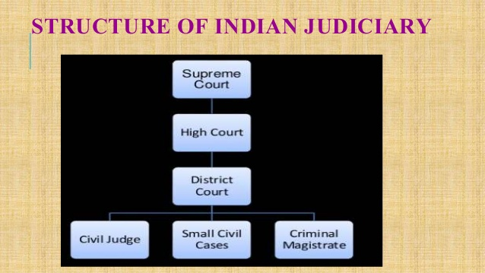

Slide 287
THE SUPREME COURT
The Indian Judicial System has the Supreme Court of India at its helm, which at present is located only in the capital city of Delhi, without any benches in any part of the nation,
and is presided by the Chief Justice of India
The President of India can always seek consultation and guidance including the opinion of the apex court and its judges.

Slide 288
THE HIGH COURT
The High Courts are also termed as the courts of equity.
is the uppermost court in that state,
It can be approached in writs not only for violation of fundamental rights , but also for any other rights of the Constitution
its powers to supervise over all its subordinate courts
Currently total 25 high courts in india

Slide 289
High Courts frame their own rules, and arrange to implement them but under certain provisions of Law
All the High Courts have different division benches in different parts of the respective states for speedier cheaper and effective dispensing of justice.
Every State has a High Court, which works under the direct guidance and supervision of the Supreme Court of India

Slide 290
The District Courts
The highest court in each district is that of the District court
The district court is presided over by one District Judge appointed by the state Government.
In addition to the district judge there may be number of Additional District Judges and Assistant District Judges depending on the workload.

Slide 291
All are judicially integrated, appeal system is present.

Slide 292
COMMAN LAW
Common law refers to law developed by judges through decisions of courts, rather than through legislative
The basis for common law is tradition, past practices, and legal precedents set by the courts
Common law seeks “interpretation through the past decisions of higher courts

Slide 293
The body of precedent is called “common law” and it binds future decisions.
In future cases, when parties disagree on what the law is, an idealized common law court looks to past precedential decisions of relevant courts.
If a similar dispute has been resolved in the past, the court is bound to follow the reasoning used in the prior decision

Slide 294
If however, the court finds that the current dispute is fundamentally distinct from all previous cases, judges have the authority and duty to make law by creating precedent.
Thereafter, the new decision becomes precedent, and will bind future courts.

Slide 295
Arbitration
Arbitration is a process in which the conflicting parties agree to refer their dispute to a neutral third party known as ‘Arbitrator’.
The arbitrator listens to the view points of the conflicting parties and then gives his decision which is binding on all the parties.
The judgment on the dispute is sent to the government. The government publishes the judgment within 30 days of its submission

Slide 296
In India, there are two types of arbitration: Voluntary and Compulsory.
Voluntary Arbitration:
In voluntary arbitration both the conflicting parties appoint a neutral third party as arbitrator. The arbitrator acts only when the dispute is referred to him/her. With a view to promote voluntary arbitration, the Government of India has constituted a tripartite National Arbitration Promotion Board

Slide 297
Compulsory Arbitration:
In compulsory arbitration, the government can force the disputing parties to go for compulsory arbitration.
Both the disputing parties can request the government to refer their dispute for arbitration.
The judgment given by the arbitrator is binding on the parties of dispute.

Slide 298
Contract Law
It came into effect on the 1st of September 1872
Containing a total of 266 sections it is the principal law regulating contracts in India.
An agreement enforceable by law”

Slide 299
In other words, we can say that a contract is anything that is an agreement and enforceable by the law .
Contract = Accepted Proposal (Agreement) + Enforceable by law (defined within the law)
Agreement = Offer + Acceptance.

Slide 300
KINDS OF CONTRACT
1: According to Enforceability.
2: According to mode of creation.
3: According to Performance.

Slide 301
According to mode of creation
According to Formation a contract has the following two kinds.
Express Contract.
Implied Contract.

Slide 302
Express Contract : Express contract is one which is expressed in words spoken or written. When such a contract is formed, there is no difficulty in understanding the rights, terms, obligations and conditions of a contract.
Example: “A” gives his house on rent to “B”, on per month 10000 Rs and for one year of period, “A” mentioned terms and condition on a paper

Slide 303
Implied Contract: An implied contract is made without any words spoken and written, It arise from acts, conduct of parties, course of dealing or circumstances. Example: “A” went into a restaurant and had a cup of tea. It is implied contract that A will pay for the cup of tea

Slide 304
According to Enforceability/Validity
1. VALID
2. VOID
3. VOIDABLE
4. ILLEGAL
5. UNFORCEABLE

Slide 305
a: Valid Contract: A valid contract is enforceable by law or it is fulfilling all essentials of the law
b: Void Contract: The term void means not binding by the law due to impossibility to performance.
c. Voidable contract: such sort of contract are those which can be broken if one of the party needs to the end the contract. agreement was entered by misrepresentation or pressure

Slide 306
illegal Agreement: An agreement is illegal when its performance is forbidden by any law
Unenforceable contract: An unenforceable contract is that contract which cannot be enforced in a court of law because of some technical defects and faults such as absence of writing, registration

Slide 307
According to Performance
According to performance a contract is of following two kinds.
Executed Contract
Executory Contract

Slide 308
Executed Contract : A contract is said to be executed when both the parties have completely performed their obligations. It means that nothing remains to be done by either party under the contract.
Executory Contract : In an executory contract something remains to be done. In other words, a contract is said to be executory when both parties to a contract have yet to perform their obligations.

Slide 309
Unilateral Contract: In a unilateral contract only one party has commitment. In other words
Bilateral Contract: It is a contract where both parties are bounded to perform certain duties, responsibilities and obligations but not doing the same

Slide 310
Tort law

Slide 311
TORT LAW
The word ‘tort’ is derived from the Latin term ‘tortum’, twisted, and implies conduct which is twisted
The term ‘tort’ is the French equivalent of the English word ‘wrong’
TORT LAW IS BASED ON THE IDEA THAT EVERYONE IN OUR SOCIETY HAS CERTAIN RIGHTS

Slide 312
Along With Having Certain Rights, Everyone Has The Duty to Respect the Rights of Others.
The Purpose of Tort Law is to Enforce Those Rights and Duties
The person committing a tort or wrong is called a tort-feasor or wrong doer, and his misdoing is a tortious act
The principal aim of the law of torts is compensation of victims or their dependants.

Slide 313
Objects of Law of Torts
1. Afford compensation.
2. Shifting of loss to person who caused it or to the beneficiary.
3. To protect the interests and rights of a person like, property, person and reputation.
4. To provide appropriate remedy for violation of rights.

Slide 314
The law of Torts in India is based on the English Law of Torts.
It is made applicable in India as per the circumstances.
Development of Law of Torts in India is very slow because…
1.. Lack of right consciousness.
2. Habit of tolerance.
3. Delayed judicial proceeding.
4. Inability of the wrongdoer to pay damages

Slide 315
Essentials/elements of Torts
1. Wrongful act
2. Legal damage
3. Legal remedy

Slide 316
1. Wrongful act
The act complained must be legally wrongful act.
An act will be ‘wrongful’ when it affect someone’s legal right
This is ‘wrongful’ because, there must have been a breach of duty which has been fixed by law itself.

Slide 317
LEGAL DAMAGE
There must be violation of a legal right of a person and, if it is not, there can be no action under law of torts.
There must be a damage by the wrongful act
LEGAL Remedy
There should be a remedy present for a particular case

Slide 318
It has two principles
1.DamnumSine Injuria i.e. damage without injury, but legal right is also not damage
2. Injuria Sine Dumnum: i.e. damage without injury, but legal right is also damage

Slide 319
Types of torts
There are three types of torts
1. Intentional: Assault, mental stress etc
2. Negligence: Due to careless. Eg. accidents etc
3. Strict liabilities: Duty without fault

Slide 320
Intellectual Property Laws
Intellectual property (IP) refers to creations of the mind, such as inventions; literary and artistic works; designs; and symbols, etc
Intellectual Property Rights = the holder of one of these abstract properties has certain exclusive rights to the creative work, commercial symbol, invention etc

Slide 321
Intellectual property rights allow the originator of certain ideas, inventions, and expressions to exclude others from using those ideas, inventions, and expressions without permission.
Laws that protects the Intellectual property Right is known as Intellectual Property Right

Slide 322
Types of intellectual Property
Copyrights
Trade Marks
•Patents

Slide 323
Copyright protects “Expressive work”.
•Trademark protects marks that are placed on goods to distinguish them from other work.
•Patent protects “Inventions”.

Slide 324
Patent
When inventor creates anything new by applying his intellect, labour and skill, the product so obtained becomes his Patent
It is a form of Intellectual property

Slide 325
objectives
To encourage inventions
To develop scientific thinking
To introduce new techniques and methods
To promote rapid development

Slide 326
Not the patents
Projects without novelty
Which is against human health
Those are baseless
Plants ,animals and their parts

Slide 327
What is patentable
It must be novel
It must be useful
It must be non obvious

Slide 328
Procedure
1. Presentation of Application
It can be filed by real inventor, assignee of the inventor and any legal representative
Application shall be filed in a prescribed form in the patent office
Following things will be mentioned like
Date of application
Name of the office

Slide 329
Details of the product
Diagrams etc
2. publication of the application
Invention will not open for public before 18 months after date of filing the application
But applicant can request the registrar for its publication

Slide 330
3. examination of application
Controller will send the application form to the examiner
Examiner will examine the form and submit his report within the prescribed time
He will consider mainly two points
Whether invention has been published before
Whether any person has claimed the same

Slide 331
4.Objections to the patent
After taking the report from the examiner the controller or any person can raise any objections before granting
Similarly after granting the patent within one year objections can be raised
Objection board will be constituted for it
Process will be done

Slide 332
5. Granting of the patent
Granting will be done on the basis of following points
1.application made by patentee is correct
2.application has been accepted by the controller
3. if does not violet Patent Act
Entry will be made in the register

Slide 333
Rights
RIGHT TO USE PATENT
He acquires Monopoly. He enjoys exclusive right on it
He check nobody should use his patent and sell it

Slide 334
Right to surrender the patent
He can surrender the patent to the controller anytime
Controller will publish it and inform the interested person

Slide 335
Right of Assignment
He has right to assign his patent fully or partially
It is made by written agreement

Slide 336
Right to grant License
He can issue the license to any person to use his patent
Right to bring Suit
He has right to bring suit against the violator

Slide 337
Infringement of the Patent
When anybody violates the right of the Patentee, it is known as infringement
Following acts are considered as an infringement
To copy the invention and prepare similar device
To develop mini form of invention
To grasp the fundamental features of the invention

Slide 338
Copy right
Rights given to the creator for his/her creativity.
to print , publish and sell
To prevent unauthorized work
Cinematography
Musical works
Literary work
Dramatic
Artistic

Slide 339
Literary : books etc
Artistic; painter, photographer
Musical; all are included

Slide 340
Registration
file an application
2. Examination
3. Registration

Slide 341
RTI, ACT, 2005
RIGHT TO INFORMATION ACT
This Act allows the public to seek information from any governmental department.
It increases accountability and transparency of the establishment.
Transparency is an important feature of good governance. The Right to information is the back­bone of a democracy

Slide 342
Sections
1.Right to whom
2.About Officers
3.manner of filing
4.dispoal of request
5.exempted cases
6.Appeal
7.Penalty
8.Jurisdiction
9.Role of Government

Slide 343
There are various sections to explain it
1.Right to whom ..citizen
2. about officers :
PIO
APIO
3. Manner of the filing
submission of the application with fee (10 rs) and particulars. It may be in Hindi , English or local .

Slide 344
4. disposal of the request
Time limits to get the information
30 days if application is filed with the PIO.
35 days in case it is filed with the Assistant PIO.
48 hours in case the matter to which the information pertains affects the life and liberty of an individual.

Slide 345
5. Exempted case
a) National security
(b) Contempt of court
c) Parliamentary privilege
(d) Trade secrecy (g) Safety of informer in law enforcement (h) Investigation (i) Cabinet papers (j) Privacy K) Copyright - disclosure which would involve an infringement of copyright subsisting in a person other than the State may be rejected.

Slide 346
6. Appeal:
First appeal to the senior in the department
Second appeal to the information commissioner
30 +15 days to PIO
90 days to IC

Slide 347
7. PENALTY
CASES may be
Application not accepted without any reason
Rejected without reason
Providing wrong and incomplete
Obstruct flow of the information
Destroyed
250 per day
Maximum up to 25000/

Slide 348
8. Role of local courts
No jurisdiction to lower courts
Only High court and Supreme court has power
9. role of Government
Awareness programs
User Guide on Google
Details of PIO AND APIO
Training of public officers

Slide 349
Information Technology Act,2000

